Slide 1

HADOOP FUNDAMENTALS

Slide 2
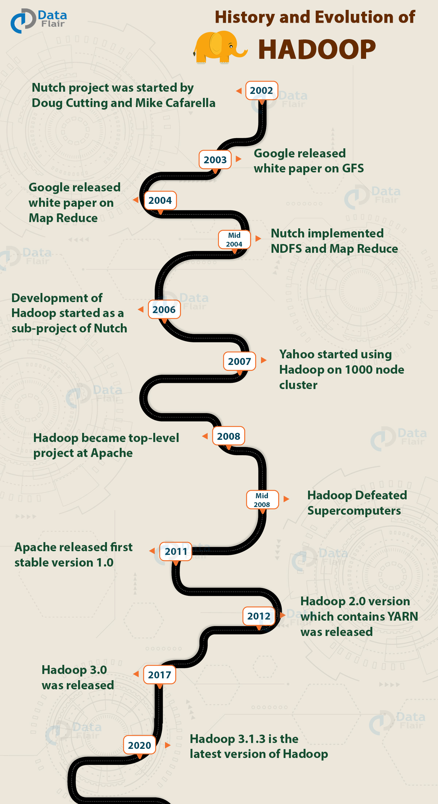

Slide 3
CONTENTS
Hadoop Ecosystem Introduction
Intro to HDFS
Evolution of Hadoop
HDFS Commands

Slide 4
Hadoop - Introduction
Hadoop is an Apache open source framework written in java that allows distributed processing of large datasets across clusters of computers using simple programming models.
The Hadoop framework application works in an environment that provides distributed storage and computation across clusters of computers.
Hadoop is designed to scale up from single server to thousands of machines, each offering local computation and storage.

Slide 5
Hadoop Architecture
At its core, Hadoop has two major layers namely −
Processing/Computation layer (MapReduce), and
Storage layer (Hadoop Distributed File System).

Slide 6
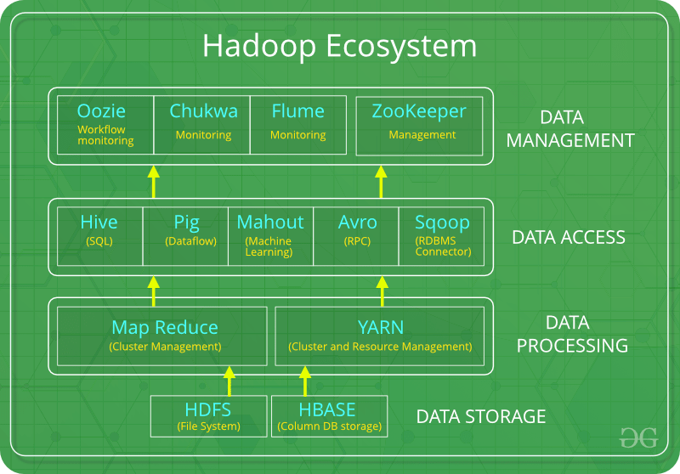

Slide 7
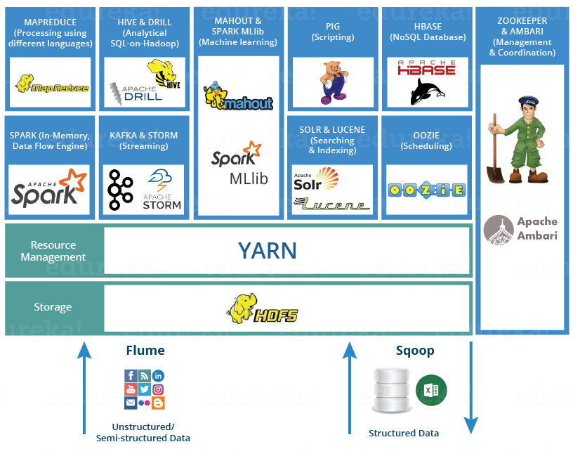

Slide 8
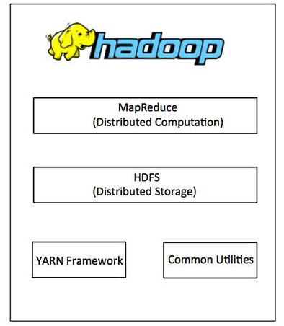
Hadoop Architecture

Slide 9
MapReduce
MapReduce is a parallel programming model for writing distributed applications devised at Google for efficient processing of large amounts of data (multi-terabyte data-sets), on large clusters (thousands of nodes) of commodity hardware in a reliable, fault-tolerant manner.
The MapReduce program runs on Hadoop which is an Apache open-source framework.

Slide 10
Hadoop Distributed File System
The Hadoop Distributed File System (HDFS) is based on the Google File System (GFS) and provides a distributed file system that is designed to run on commodity hardware.
It has many similarities with existing distributed file systems.
However, the differences from other distributed file systems are significant.
It is highly fault-tolerant and is designed to be deployed on low-cost hardware.
It provides high throughput access to application data and is suitable for applications having large datasets.

Slide 11
Hadoop Common and YARN
Apart from the above-mentioned two core components, Hadoop framework also includes the following two modules −
Hadoop Common − These are Java libraries and utilities required by other Hadoop modules.
Hadoop YARN − This is a framework for job scheduling and cluster resource management.

Slide 12
How does Hadoop work?
It is quite expensive to build bigger servers with heavy configurations that handle large scale processing, but as an alternative, you can tie together many commodity computers with single-CPU, as a single functional distributed system and practically, the clustered machines can read the dataset in parallel and provide a much higher throughput.
Moreover, it is cheaper than one high-end server.
So this is the first motivational factor behind using Hadoop that it runs across clustered and low-cost machines.

Slide 13
Hadoop runs code across a cluster of computers. This process includes the following core tasks that Hadoop performs −
Data is initially divided into directories and files. Files are divided into uniform sized blocks of 128M and 64M (preferably 128M).
These files are then distributed across various cluster nodes for further processing.
HDFS, being on top of the local file system, supervises the processing.
Blocks are replicated for handling hardware failure

Slide 14
Checking that the code was executed successfully.
Performing the sort that takes place between the map and reduce stages.
Sending the sorted data to a certain computer.
Writing the debugging logs for each job.

Slide 15
Advantages of Hadoop
Hadoop framework allows the user to quickly write and test distributed systems. It is efficient, and it automatic distributes the data and work across the machines and in turn, utilizes the underlying parallelism of the CPU cores.
Hadoop does not rely on hardware to provide fault-tolerance and high availability (FTHA), rather Hadoop library itself has been designed to detect and handle failures at the application layer. Servers can be added or removed from the cluster dynamically and Hadoop continues to operate without interruption.
Another big advantage of Hadoop is that apart from being open source, it is compatible on all the platforms since it is Java based.

Slide 16
Hadoop - Environment Setup
Hadoop is supported by GNU/Linux platform and its flavors.
Therefore, we have to install a Linux operating system for setting up Hadoop environment.
In case you have an OS other than Linux, you can install a Virtualbox software in it and have Linux inside the Virtualbox.

Slide 17
Pre-installation Setup
Before installing Hadoop into the Linux environment, we need to set up Linux using ssh (Secure Shell). Follow the steps given below for setting up the Linux environment.
Creating a User
At the beginning, it is recommended to create a separate user for Hadoop to isolate Hadoop file system from Unix file system. Follow the steps given below to create a user −
Open the root using the command “su”.
Create a user from the root account using the command “useradd username”.
Now you can open an existing user account using the command “su username”.

Slide 18
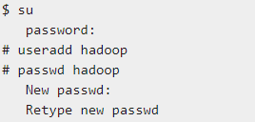
Open the Linux terminal and type the following commands to create a user.

Slide 19

SSH Setup and Key Generation
SSH setup is required to do different operations on a cluster such as starting, stopping, distributed daemon shell operations.
To authenticate different users of Hadoop, it is required to provide public/private key pair for a Hadoop user and share it with different users.The following commands are used for generating a key value pair using SSH.
Copy the public keys form id_rsa.pub to authorized_keys, and provide the owner with read and write permissions to authorized_keys file respectively.

Slide 20
Installing Java
Java is the main prerequisite for Hadoop.
First of all, you should verify the existence of java in your system using the command “java -version”.
The syntax of java version command is given below.

Slide 21

If everything is in order, it will give you the following output.
If java is not installed in your system, then follow the steps given below for installing java.

Slide 22
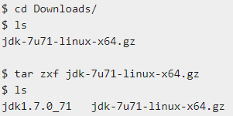
Step 1
Download java (JDK <latest version> - X64.tar.gz) by visiting the following link www.oracle.com
Then jdk-7u71-linux-x64.tar.gz will be downloaded into your system.
Step 2
Generally you will find the downloaded java file in Downloads folder. Verify it and extract the jdk-7u71-linux-x64.gz file using the following commands.

Slide 23


Step 3
To make java available to all the users, you have to move it to the location “/usr/local/”. Open root, and type the following commands.
Step 4
For setting up PATH and JAVA_HOME variables, add the following commands to ~/.bashrc file.

Slide 24
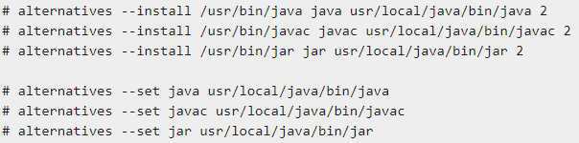
Now apply all the changes into the current running system.
Step 5
Use the following commands to configure java alternatives −
Now verify the java -version command from the terminal as explained above.

Slide 25
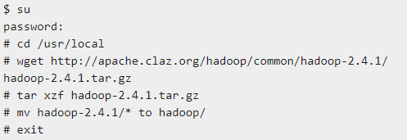
Downloading Hadoop
Download and extract Hadoop 2.4.1 from Apache software foundation using the following commands.

Slide 26
Hadoop Operation Modes
Once you have downloaded Hadoop, you can operate your Hadoop cluster in one of the three supported modes −
Local/Standalone Mode − After downloading Hadoop in your system, by default, it is configured in a standalone mode and can be run as a single java process.
Pseudo Distributed Mode − It is a distributed simulation on single machine. Each Hadoop daemon such as hdfs, yarn, MapReduce etc., will run as a separate java process. This mode is useful for development.
Fully Distributed Mode − This mode is fully distributed with minimum two or more machines as a cluster. We will come across this mode in detail in the coming chapters.

Slide 27
Installing Hadoop in Standalone Mode
The installation of Hadoop 2.4.1 in standalone mode.
There are no daemons running and everything runs in a single JVM. Standalone mode is suitable for running MapReduce programs during development, since it is easy to test and debug them.
Setting Up Hadoop
You can set Hadoop environment variables by appending the following commands to ~/.bashrc file.

Slide 28
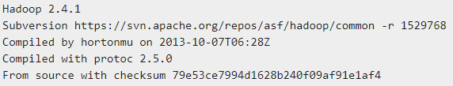
Before proceeding further, you need to make sure that Hadoop is working fine. Just issue the following command −
If everything is fine with your setup, then you should see the following result −
It means your Hadoop's standalone mode setup is working fine. By default, Hadoop is configured to run in a non-distributed mode on a single machine.

Slide 29
Example
Hadoop installation delivers the following example MapReduce jar file, which provides basic functionality of MapReduce and can be used for calculating, like Pi value, word counts in a given list of files, etc.

Slide 30
Let's have an input directory where we will push a few files and our requirement is to count the total number of words in those files.
To calculate the total number of words, we do not need to write our MapReduce, provided the .jar file contains the implementation for word count.
You can try other examples using the same .jar file; just issue the following commands to check supported MapReduce functional programs by hadoop-mapreduce-examples-2.2.0.jar file.

Slide 31


Step 1
Create temporary content files in the input directory. You can create this input directory anywhere you would like to work.
It will give the following files in your input directory −
These files have been copied from the Hadoop installation home directory. For your experiment, you can have different and large sets of files

Slide 32
Step 2
Let's start the Hadoop process to count the total number of words in all the files available in the input directory, as follows −
Step 3
Step-2 will do the required processing and save the output in output/part-r00000 file, which you can check by using −
It will list down all the words along with their total counts available in all the files available in the input directory.

Slide 33
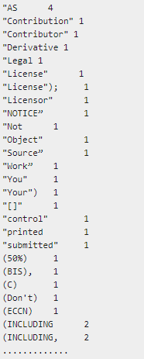

Slide 34
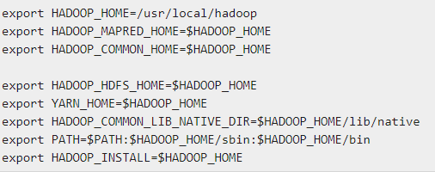
Installing Hadoop in Pseudo Distributed Mode
Follow the steps given below to install Hadoop 2.4.1 in pseudo distributed mode.
Step 1 − Setting Up Hadoop
You can set Hadoop environment variables by appending the following commands to ~/.bashrc file.

Slide 35
Now apply all the changes into the current running system.
Step 2 − Hadoop Configuration
You can find all the Hadoop configuration files in the location “$HADOOP_HOME/etc/hadoop”. It is required to make changes in those configuration files according to your Hadoop infrastructure.

Slide 36
In order to develop Hadoop programs in java, you have to reset the java environment variables in hadoop-env.sh file by replacing JAVA_HOME value with the location of java in your system.
The following are the list of files that you have to edit to configure Hadoop.

Slide 37
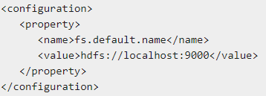
core-site.xml
The core-site.xml file contains information such as the port number used for Hadoop instance, memory allocated for the file system, memory limit for storing the data, and size of Read/Write buffers.
Open the core-site.xml and add the following properties in between <configuration>, </configuration> tags.

Slide 38
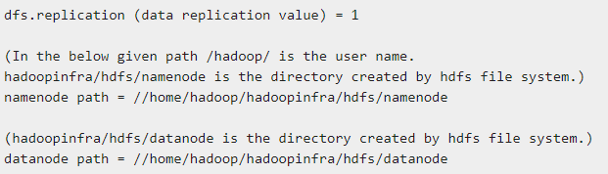
hdfs-site.xml
The hdfs-site.xml file contains information such as the value of replication data, namenode path, and datanode paths of your local file systems. It means the place where you want to store the Hadoop infrastructure.
Let us assume the following data.

Slide 39
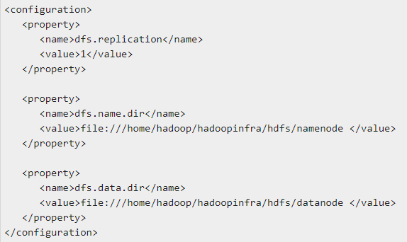
Open this file and add the following properties in between the <configuration> </configuration> tags in this file.

Slide 40
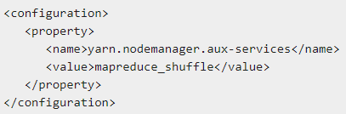
yarn-site.xml
This file is used to configure yarn into Hadoop. Open the yarn-site.xml file and add the following properties in between the <configuration>, </configuration> tags in this file.

Slide 41
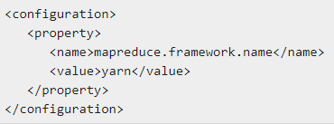
mapred-site.xml
This file is used to specify which MapReduce framework we are using. By default, Hadoop contains a template of yarn-site.xml. First of all, it is required to copy the file from mapred-site.xml.template to mapred-site.xml file using the following command.
Open mapred-site.xml file and add the following properties in between the <configuration>, </configuration>tags in this file.

Slide 42

Verifying Hadoop Installation
The following steps are used to verify the Hadoop installation.
Step 1 − Name Node Setup
Set up the namenode using the command “hdfs namenode -format” as follows.

Slide 43
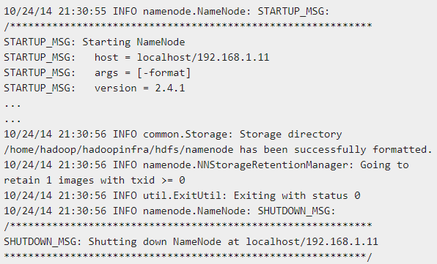
The expected result is as follows.

Slide 44
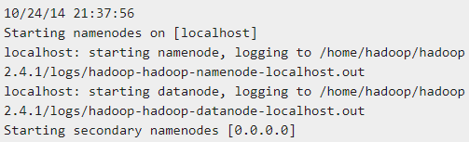
Step 2 − Verifying Hadoop dfs
The following command is used to start dfs. Executing this command will start your Hadoop file system.
The expected output is as follows −

Slide 45
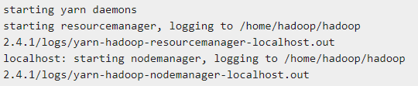
Step 3 − Verifying Yarn Script
The following command is used to start the yarn script. Executing this command will start your yarn daemons.
The expected output as follows −

Slide 46
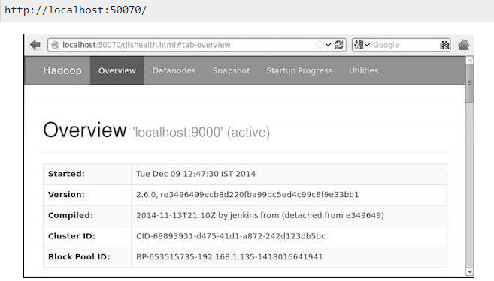
Step 4 − Accessing Hadoop on Browser
The default port number to access Hadoop is 50070. Use the following url to get Hadoop services on browser.

Slide 47
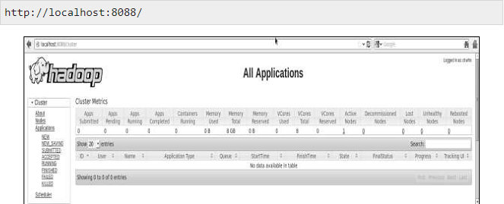
Step 5 − Verify All Applications for Cluster
The default port number to access all applications of cluster is 8088. Use the following url to visit this service.

Slide 48
Hadoop - HDFS Overview
Hadoop File System was developed using distributed file system design.
It is run on commodity hardware. Unlike other distributed systems, HDFS is highly fault tolerant and designed using low-cost hardware.
HDFS holds very large amount of data and provides easier access.
To store such huge data, the files are stored across multiple machines. These files are stored in redundant fashion to rescue the system from possible data losses in case of failure.
HDFS also makes applications available to parallel processing.

Slide 49
Features of HDFS
It is suitable for the distributed storage and processing.
Hadoop provides a command interface to interact with HDFS.
The built-in servers of namenode and datanode help users to easily check the status of cluster.
Streaming access to file system data.
HDFS provides file permissions and authentication.

Slide 50
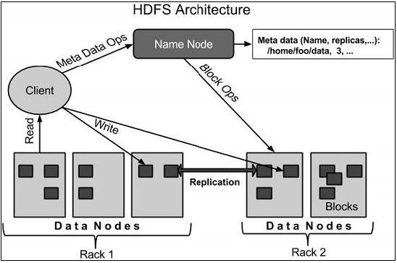
HDFS ARCHITECTURE
Given below is the architecture of a Hadoop File System. HDFS follows the master-slave architecture and it has the following elements.

Slide 51
Namenode
The namenode is the commodity hardware that contains the GNU/Linux operating system and the namenode software. It is a software that can be run on commodity hardware. The system having the namenode acts as the master server and it does the following tasks −
Manages the file system namespace.
Regulates client’s access to files.
It also executes file system operations such as renaming, closing, and opening files and directories.

Slide 52
Datanode
The datanode is a commodity hardware having the GNU/Linux operating system and datanode software. For every node (Commodity hardware/System) in a cluster, there will be a datanode. These nodes manage the data storage of their system.
Datanodes perform read-write operations on the file systems, as per client request.
They also perform operations such as block creation, deletion, and replication according to the instructions of the namenode.

Slide 53
BLOCK
Generally the user data is stored in the files of HDFS.
The file in a file system will be divided into one or more segments and/or stored in individual data nodes.
These file segments are called as blocks. In other words, the minimum amount of data that HDFS can read or write is called a Block.
The default block size is 64MB, but it can be increased as per the need to change in HDFS configuration.

Slide 54
GOALS OF HDFS
Fault detection and recovery − Since HDFS includes a large number of commodity hardware, failure of components is frequent. Therefore HDFS should have mechanisms for quick and automatic fault detection and recovery.
Huge datasets − HDFS should have hundreds of nodes per cluster to manage the applications having huge datasets.
Hardware at data − A requested task can be done efficiently, when the computation takes place near the data. Especially where huge datasets are involved, it reduces the network traffic and increases the throughput.

Slide 55
Hadoop - HDFS Operations
Starting HDFS
Initially you have to format the configured HDFS file system, open namenode (HDFS server), and execute the following command.
After formatting the HDFS, start the distributed file system. The following command will start the namenode as well as the data nodes as cluster.

Slide 56
Listing Files in HDFS
After loading the information in the server, we can find the list of files in a directory, status of a file, using ‘ls’. Given below is the syntax of ls that you can pass to a directory or a filename as an argument.
Inserting Data into HDFS
Assume we have data in the file called file.txt in the local system which is ought to be saved in the hdfs file system. Follow the steps given below to insert the required file in the Hadoop file system.

Slide 57
Step 1
You have to create an input directory.
Step 2
Transfer and store a data file from local systems to the Hadoop file system using the put command.

Slide 58
Step 3
You can verify the file using ls command.
Retrieving Data from HDFS
Assume we have a file in HDFS called outfile. Given below is a simple demonstration for retrieving the required file from the Hadoop file system.
Step 1
Initially, view the data from HDFS using cat command.

Slide 59

Step 2
Get the file from HDFS to the local file system using get command.
Shutting Down the HDFS
You can shut down the HDFS by using the following command.

Slide 60
Hadoop - Command Reference
There are many more commands in "$HADOOP_HOME/bin/hadoop fs" than are demonstrated here, although these basic operations will get you started.
Running ./bin/hadoop dfs with no additional arguments will list all the commands that can be run with the FsShell system.
Furthermore, $HADOOP_HOME/bin/hadoop fs -help commandName will display a short usage summary for the operation in question, if you are stuck.

Slide 61
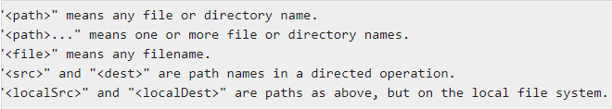
A table of all the operations is shown below. The following conventions are used for parameters −
All other files and path names refer to the objects inside HDFS.

Slide 62
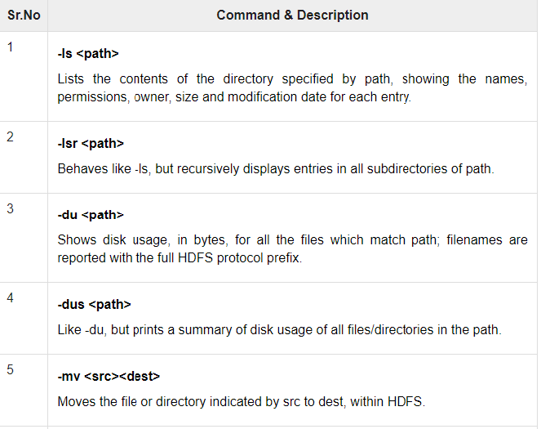

Slide 63
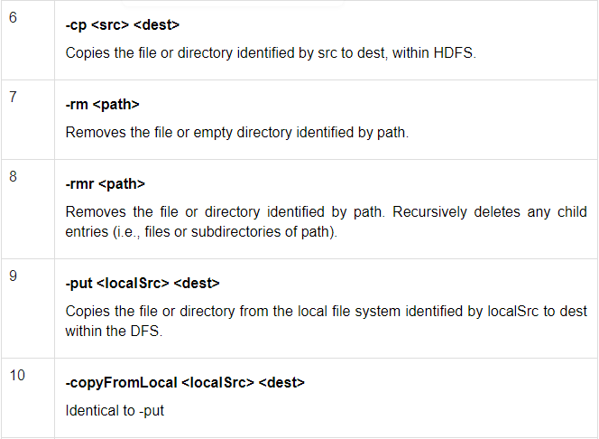

Slide 64
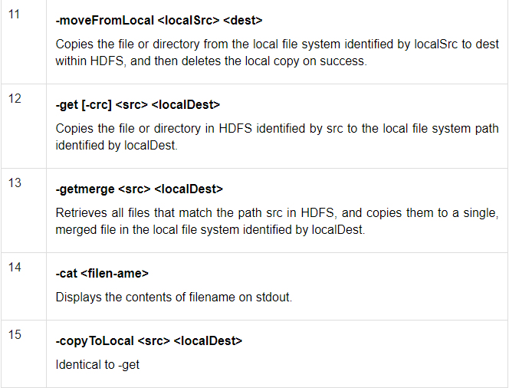

Slide 65
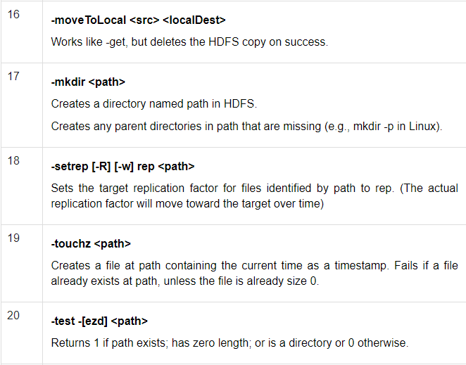

Slide 66
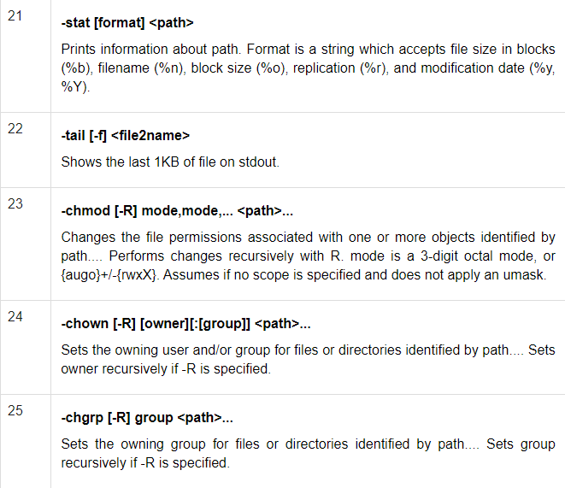

Slide 67
